Slide 1
CLR Parser
Navigating the depths of Compiler Design

Slide 2

Introduction
A CLR (Canonical LR) parser is a type of bottom-up parser used in the field of compiler design.
It is designed to analyse the syntax of a programming language based on a context-free grammar.
The term "CLR" signifies that the parser utilises a Canonical collection of LR(1) items, which represent potential parsing states incorporating a single lookahead symbol. This lookahead information enhances the parser's ability to handle a broader class of grammars compared to simpler LR or LALR parsers.

Slide 3
Key Components of CLR Parser
The CLR parsing technique involves constructing a parsing table that encodes the parser's actions based on the LR(1) items. These actions guide the parser through the process of recognising and understanding the input code.
CLR parsers are commonly employed in the development of compilers and interpreters for programming languages, aiding in the generation of abstract syntax trees and subsequent phases of language processing. The theoretical foundation of CLR parsing contributes to its versatility and efficiency in handling diverse language constructs.

Slide 4

Objective
The primary goal of this project is to implement a CLR parser capable of efficiently analysing the syntax of a programming language based on a given context-free grammar. By achieving this objective, we aim to contribute to the understanding and practical application of CLR parsing techniques in the field of compiler design. Additionally, we will discuss the broader implications of implementing a CLR parser in the context of language processing.

Slide 5
Algorithm
Augment the grammar 𝐺 with a new start symbol 𝑆 ′ and production 𝑆 ′ → 𝑆. So the new grammar is 𝐺 ′
Construct 𝐶0 = {𝐼0,𝐼1, … ,𝐼𝑛}, the collection of sets of LR(1) items for 𝐺 ′ .
State 𝑖 of the parser is constructed from 𝐼𝑖 . The parsing action for state 𝑖 is determined as follows.
If 𝐴 → 𝛼 • 𝑎𝛽, 𝑏 ∈ 𝐼𝑖 and 𝑔𝑜𝑡𝑜 𝐼𝑖 , 𝑎 = 𝐼𝑗 , then set 𝑎𝑐𝑡𝑖𝑜𝑛[𝑖, 𝑎] = "𝑠ℎ𝑖𝑓𝑡 𝑗“. Here a must be a terminal.If 𝐴 → 𝛼 •, 𝑏 ∈ 𝐼𝑖 , then set 𝑎𝑐𝑡𝑖𝑜𝑛[𝑖, 𝑏] = "𝑟𝑒𝑑𝑢𝑐𝑒 𝐴 → 𝛼“ (apply only if 𝐴 ≠ 𝑆 ′ ).
If 𝑆 ′ → 𝑆 •, $ ∈ 𝐼𝑖 , then set 𝑎𝑐𝑡𝑖𝑜𝑛[𝑖, $] = "𝑎𝑐𝑐𝑒𝑝𝑡“.
If any conflicting actions result from the above rules, we say the grammar is not LR(1). The algorithm fails to produce a parser in this case.

Slide 6

Cont …
4. The goto transitions for state 𝑖 are constructed for all nonterminals 𝐴 using the rule: If 𝐺𝑂𝑇𝑂(𝐼𝑖 , 𝐴) = 𝐼𝑗 , then 𝐺𝑂𝑇𝑂[𝑖, 𝐴] = 𝑗.
5. All entries not defined by rules (2) and (3) are made “error”.
6. The initial state of the parser is the one constructed from the set of items containing [𝑆 ′ → • 𝑆, $].

Slide 7
Parsing Table
The heart of CLR parsing lies in the construction of a parsing table. This table encapsulates the parser's actions, guiding it through the intricate process of recognizing and understanding input code.
The parsing actions are determined by LR(1) items, and this slide will delve into the specifics of how the parsing table is constructed, offering insights into the decision-making process for shifts, reduces, and error handling. By focusing on the parsing table, you maintain a balance between depth and brevity, highlighting a central concept crucial to understanding the functionality of a CLR parser.

Slide 8
Example
Lets take an example to understand CLR parsing clearly
Grammar:
S - - > AA
A - - > aA | b

Slide 9
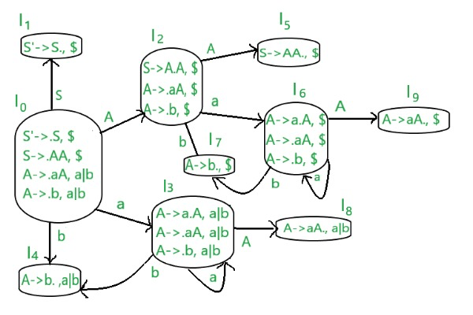
Cont …
Explanation:

Slide 10
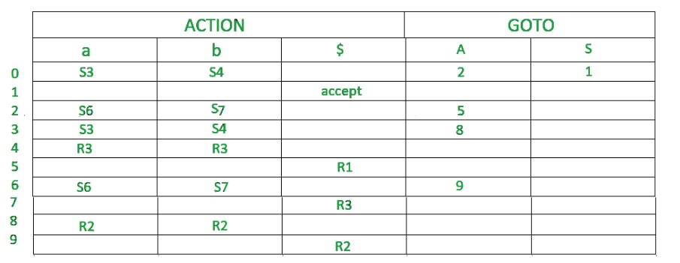
Cont …
Output

Slide 11

Conclusion
As we conclude our exploration into CLR parsing, we've uncovered the intricacies of constructing LR(1) items, building the Canonical collection, and creating a parsing table. This critical parsing table serves as the guiding force behind the CLR parser's actions, facilitating the recognition and understanding of input code. By understanding these key components, we gain insights into the versatility and efficiency of CLR parsing. This journey highlights the significance of CLR parsing in compiler design, offering a robust approach to handle diverse language constructs.

